Slide 1
AUTOMATION IN SALESFORCE
Presented By Yuvraj & Shashank​

Slide 2
INTRODUCTION
Presentation title
Automation in Salesforce refers to the use of tools and features within the Salesforce platform and execute business processes automatically, reducing manual effort and improving efficiency.

Slide 3
DIFFERENT TYPES OF AUTOMATION TOOLS
Workflow
Formula Field
Roll Up Summary
Process Builder
Approval Process
Flows

Slide 4
WORKFLOW
Many of the tasks you normally assign, the emails you regularly send, and other record updates are part of your organizations standard processes. Instead of doing this work manually, you can configure workflow to do it automatically.
Workflow Actions
1.Task
2.Email Alerts
3.Field Updates
4.Outbound Messages

Slide 5
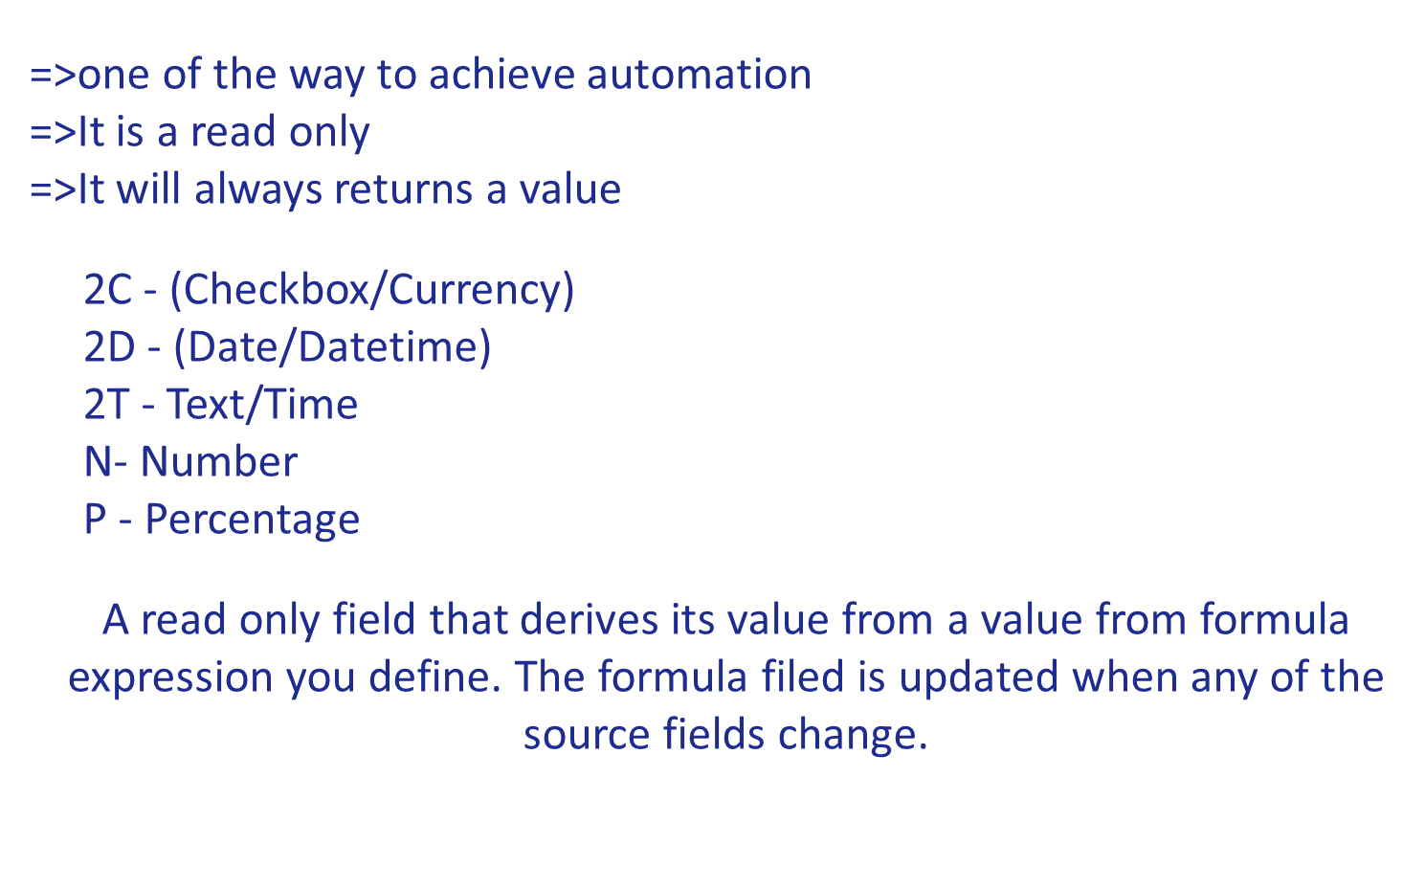
FORMULA FIELD

Slide 6
ROLL-UP SUMMERY
=>Rollup summary filed is used to perform the aggregate functions
=>Multiple input and single output
Below are the aggregate function supported by sales force
Sum
Min
Max
Count
Rollup summary is applied on parent object & Master Detail

Slide 7
PROCESS BUILDER
=>More number of conditions can be executed
=>More actions are available
=>It does not support Outbound Messages
Available Actions
Apex
Create a record
Email Alerts
Flows
Quick Actions
Send Custom Notification
Submit for Approval
Update Records
Processes
Post to Chatter
Quip

Slide 8
APPROVAL PROCESS
An approval process in Salesforce is a way to automate the approval of records, such as deals, expenses, or requests. It ensures that certain criteria are met before a record is accepted, providing a structured and automated way to manage approvals
=>Select Approver
Let the submitter choose the approver manually.
Automatically assign an approver using a standard or custom hierarchy field
Automatically assign to queue
Automatically assign to approvers

Slide 9
FLOWS
Salesforce flows are an automation tool provided by salesforce which can be used to perform various tasks like, Sending an Email, Posting a chatter, Sending custom Notification & etc, Flow is the most powerful automation tool provided by Salesforce. It can be trigger for record insert, update and record delete and it can be run for both after and before events.

Slide 10
TYPES OF FLOWS
1 Screen Flow
2 Record-Triggered Flow
3 Scheduled-triggered Flow
4 Platform Event Flow
5 Auto Launched Flow

Slide 11
SCREEN FLOW
With Screen Flow you can create a custom Ui (user Interface) and guide users through a business process that can be launched from lighting Pages, Experience Cloud ( previously known ad Community Cloud ) and more.
Record-Triggered Flow
Record-Triggered Flow launches when is record is created, updated or deleted. So far, we have used Apex triggers for these automations some of which can now be done using flows.

Slide 12
SCHEDULED-TRIGGERED FLOW
This flow launches at the specified time and frequency for each record in a batch. Traditionally we have met this kind of requirements using Apex Batch jobs.
Platform Event Flow
Platform event flow launches when a platform event message is received.
Auto Launched Flow
Auto launches flow when invoked by Apex, process builder or even Rest API

Slide 13
WHY FLOW?
Flow is capable of so much more than either Workflow Rules or Process Builder, and the majority of parity gaps have been addressed.
In Particular, Flow offers:
=>Better overall performance.
=>Functionality to improve high-volume automation such as Fast Field Updates ( Before Save) =>Powerful error handling and debugging.
=>Repeatable and reusable functionality such as the use of sub-flows.
=>Additional features such as Screen Flows.
=>Even you can trap the delete event from the record trigger flow.

Slide 14
THANK YOU

